Slide 1

Graph Theory Introduction
Written by Rachel J. Morris, last updated Mar 26, 2018

Slide 2

About
Now we’re starting a whole new topic – graph theory. We need to cover some terminology and notation first.

Slide 3
Topics
1. Intro to Graphs
2. Graph Terminology
3. Eulerian Graphs

Slide 4

Intro to Graphs

Slide 5

1. Intro to Graphs
Notes
Node/Vertex: A point in the graph, that acts as an end-point between edges.
Edge: A line that connects two vertices (or a single vertex to itself)
Graph Theory is a visual way we can represent relationships between objects.
In a graph, we have nodes (aka vertices) that represent some kind of data, and edges that join two nodes together. These edges can be directed or undirected. The edges may or may not have a weight associated with them.
A
Kansas City
8
16
B
C
Shawnee
26
Raytown
(<number>/29)

Slide 6
1. Intro to Graphs
Notes
Node/Vertex: A point in the graph, that acts as an end-point between edges.
Edge: A line that connects two vertices (or a single vertex to itself)
In Computer Science, data may be represented with graphs as well. There are also Graph-based database systems like Neo4j, which is different from a more traditional relational database system.
(<number>/29)

Slide 7
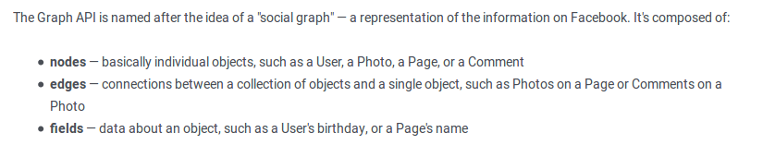
1. Intro to Graphs
Notes
Node/Vertex: A point in the graph, that acts as an end-point between edges.
Edge: A line that connects two vertices (or a single vertex to itself)
Example: Facebook Graph API
https://developers.facebook.com/docs/graph-api/overview/
id
Post
id
posts
create_time
Person
message
id
name
locale
Post
create_time
age_range
message
(<number>/29)

Slide 8
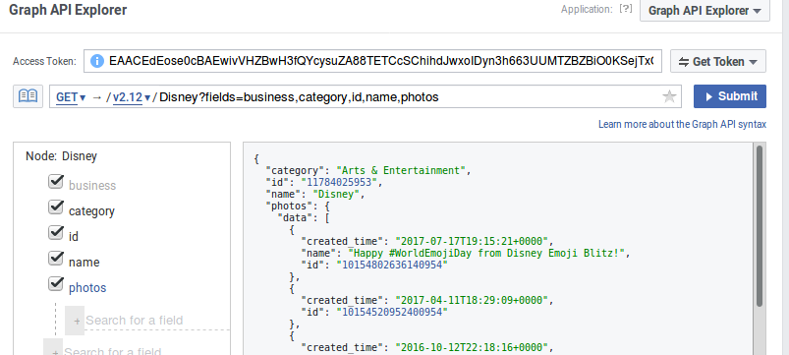
1. Intro to Graphs
Notes
Node/Vertex: A point in the graph, that acts as an end-point between edges.
Edge: A line that connects two vertices (or a single vertex to itself)
Example: Facebook Graph API
Explore the Graph API: https://developers.facebook.com/tools/explorer/
(<number>/29)

Slide 9
1. Intro to Graphs
Notes
Node/Vertex: A point in the graph, that acts as an end-point between edges.
Edge: A line that connects two vertices (or a single vertex to itself)
Other uses of Graph Theory in Computer Science:
Database relationships
Data flow diagrams
Representation of computer networks
Data mining
Image processing
Information from
http://research.ijcaonline.org/volume104/number1/pxc3899025.pdf
(<number>/29)

Slide 10
Graph Terminology

Slide 11
2. Graph Terminology
Notes
Node/Vertex: A point in the graph, that acts as an end-point between edges.
Edge: A line that connects two vertices (or a single vertex to itself)
A graph, at minimum, has nodes/vertices and edges.
We can think of a graph as having a set V of vertices, and a set E of edges.
V = { A, B, C }
E = { (B, A), (A, C), (B, C) }
B to A, A to C, and B to C
A
B
C
(<number>/29)

Slide 12
2. Graph Terminology
Notes
Node/Vertex: A point in the graph, that acts as an end-point between edges.
Edge: A line that connects two vertices (or a single vertex to itself)
There’s a lot of terminology to cover, so I’ll try to cover it in an easy-to-look-up way…
(<number>/29)

Slide 13
2. Graph Terminology
Notes
Loop: An edge where both its endpoints are the same vertex.
Parallel edges: Two edges that have the same two endpoints.
Adjacent nodes: Two nodes that are joined by an edge.
Loop: A vertex-edge-vertex grouping where the endpoints are the same vertex.
Parallel/Multiple Edges: Two edges that share the same two endpoints.
Adjacent Nodes (vertices): Two nodes that are joined by an edge.
A and B are adjacent, and A and C are adjacent.
A
B
C
A
B
A
B
C
(<number>/29)

Slide 14
2. Graph Terminology
Notes
Loop: An edge where both its endpoints are the same vertex.
Parallel edges: Two edges that have the same two endpoints.
Adjacent nodes: Two nodes that are joined by an edge.
deg(A) = 4
Degree: The degree of a vertex, deg(v), is the number of times that v is an endpoint of an edge. Loops are counted twice.
A
B
C
deg(B) = 2
deg(C) = 1
(<number>/29)

Slide 15
2. Graph Terminology
Notes
Loop: An edge where both its endpoints are the same vertex.
Parallel edges: Two edges that have the same two endpoints.
Adjacent nodes: Two nodes that are joined by an edge.
deg(A) = 4
Degree: The degree of a vertex, deg(v), is the number of times that v is an endpoint of an edge. Loops are counted twice.
Connected: A graph is connected if there is a walk between any two pair of nodes.
A
B
C
deg(B) = 2
deg(C) = 1
A
Connected
B
C
NOT connected
A
B
C
(<number>/29)

Slide 16
2. Graph Terminology
Notes
Loop: An edge where both its endpoints are the same vertex.
Parallel edges: Two edges that have the same two endpoints.
Adjacent nodes: Two nodes that are joined by an edge.
Subgraph: A graph B is a subgraph of A if all nodes in B are also in A, and all edges in B are also in A.
B
A
C
D
Graph A
B
A
C
D
Graph B
(<number>/29)

Slide 17
2. Graph Terminology
Notes
Loop: An edge where both its endpoints are the same vertex.
Parallel edges: Two edges that have the same two endpoints.
Adjacent nodes: Two nodes that are joined by an edge.
Walk: A series of alternating vertices/edges.
Walk: A sequence of alternating vertices/edges, beginning and ending with vertices.
For this graph, a walk could be
A → B → C
A
B
C
A
B
C
(<number>/29)

Slide 18
2. Graph Terminology
Notes
Loop: An edge where both its endpoints are the same vertex.
Parallel edges: Two edges that have the same two endpoints.
Adjacent nodes: Two nodes that are joined by an edge.
Walk: A series of alternating vertices/edges.
Closed walk: A walk that begins & ends at the same vertex.
Walk: A sequence of alternating vertices/edges, beginning and ending with vertices.
Closed walk: A walk that begins and ends at the same vertex.
The example here is
A → B → C → A
A
B
C
A
B
C
(<number>/29)

Slide 19
2. Graph Terminology
Notes
Loop: An edge where both its endpoints are the same vertex.
Parallel edges: Two edges that have the same two endpoints.
Adjacent nodes: Two nodes that are joined by an edge.
Walk: A series of alternating vertices/edges.
Closed walk: A walk that begins & ends at the same vertex.
Walk length: The amount of edges in a walk.
Walk: A sequence of alternating vertices/edges, beginning and ending with vertices.
Closed walk: A walk that begins and ends at the same vertex.
Length of a walk: The amount of edges in the walk.
For A → B → C → A, the length is 3.
A
B
C
A
B
C
(<number>/29)

Slide 20
2. Graph Terminology
Notes
Loop: An edge where both its endpoints are the same vertex.
Parallel edges: Two edges that have the same two endpoints.
Adjacent nodes: Two nodes that are joined by an edge.
Walk: A series of alternating vertices/edges.
Closed walk: A walk that begins & ends at the same vertex.
Walk length: The amount of edges in a walk.
Walk: A sequence of alternating vertices/edges, beginning and ending with vertices.
Trivial: A walk of length 0 (no edges) is a trivial walk.
A
B
C
(<number>/29)

Slide 21
2. Graph Terminology
Notes
Walk: A series of alternating vertices/edges.
Trail: A walk with no repeated edges.
A
Trail: A trail is a walk with no repeated edges.
For example:
A → B → E → C → D → E
B
E
C
D
(<number>/29)

Slide 22
2. Graph Terminology
Notes
Walk: A series of alternating vertices/edges.
Trail: A walk with no repeated edges.
Path: A walk with no repeated vertices.
A
Trail: A trail is a walk with no repeated edges.
Path: A walk with no repeated vertices (and therefore no repeated edges).
B
E
C
D
A
B
E
C
D
(<number>/29)

Slide 23
2. Graph Terminology
Notes
Walk: A series of alternating vertices/edges.
Trail: A walk with no repeated edges.
Path: A walk with no repeated vertices.
Circuit: A closed trail.
Cycle: A nontrivial circuit where the only repeated nodes are the first/last ones.
A
Trail: A trail is a walk with no repeated edges.
Circuit: A closed trail – the walk begins and ends at the same vertex.
Cycle: A nontrivial circuit where the only repeated node is the begin/end.
B
E
C
D
A
B
E
C
D
A
B
E
C
D
(<number>/29)

Slide 24
2. Graph Terminology
Notes
Walk: A series of alternating vertices/edges.
Trail: A walk with no repeated edges.
Path: A walk with no repeated vertices.
Circuit: A closed trail.
Cycle: A nontrivial circuit where the only repeated nodes are the first/last ones.
Eulerian Trail: A trail where every edge is traversed.
A
Trail: A trail is a walk with no repeated edges.
Eulerian Trail: A trail where every edge is traversed.
B
E
C
D
A
B
E
C
D
Note: This graph is not the same as above; I had to change it to access all edges.
(<number>/29)

Slide 25
Eulerian Graphs

Slide 26
3. Eulerian Graphs
Notes
Walk: A series of alternating vertices/edges.
Trail: A walk with no repeated edges.
Path: A walk with no repeated vertices.
Circuit: A closed trail.
Cycle: A nontrivial circuit where the only repeated nodes are the first/last ones.
Eulerian Trail: A trail where every edge is traversed.
A
Eulerian Trail: A trail where every edge is traversed.
A graph is called Eulerian if there exists a circuit in the graph that traverses every edge exactly once.
B
E
C
D
(<number>/29)

Slide 27
3. Eulerian Graphs
Notes
Walk: A series of alternating vertices/edges.
Trail: A walk with no repeated edges.
Path: A walk with no repeated vertices.
Circuit: A closed trail.
Cycle: A nontrivial circuit where the only repeated nodes are the first/last ones.
Eulerian Trail: A trail where every edge is traversed.
Practice: Which of the following graphs are Eulerian?
B
B
A
B
A
C
A
C
F
F
D
C
E
D
E
D
(<number>/29)

Slide 28
3. Eulerian Graphs
Notes
Walk: A series of alternating vertices/edges.
Trail: A walk with no repeated edges.
Path: A walk with no repeated vertices.
Circuit: A closed trail.
Cycle: A nontrivial circuit where the only repeated nodes are the first/last ones.
Eulerian Trail: A trail where every edge is traversed.
Practice: Which of the following graphs are Eulerian?
B
B
A
B
A
C
A
C
???
F
F
D
C
E
???
D
E
D
Eulerian
Not Eulerian
Eulerian
(<number>/29)

Slide 29
Conclusion
Make sure you keep a reference of the different terminology as you’re working through these concepts.
Next time we will cover more terminology and look at trees.

